Slide 1

KALINGA INSTITUTE OF INDUSTRIAL TECHNOLOGY
Index
School Of Computer
Engineering

Slide 2
Chapter Contents
Index
Single-Level Indexes
Primary Indexes
Clustering Indexes
Secondary Indexes
Dense/Sparse Indexes
Multilevel Indexing
Search Trees B-Trees
B+-Trees
B-Trees vs. B+-Trees

Slide 3
Memory Structure
Database in stored in hard disk.
File system creates logical blocks over physical structure of disk.
1 disk block = 1 or 2 sector in disk
= 512 Bytes to 2KB size

Slide 4
Fix & Variable Length Records
Fix - Each record in database has a fixed length.
If needed padding might be used to keep the length fixed.
Variable - Variable length records are allowed.

Slide 5
Spanned vs Unspanned Storage
Spanned: If a record is allowed to be stored in multiple blocks (in parts) then it is spanned storage.
Unspanned: Record is not allowed to be split among two or more blocks even if block has some free space.

Slide 6
Index
An index is a data structure that organizes data records on disk to optimize the retrieval operations. An index is used to efficiently retrieve all records that satisfy search conditions on the search key fields of the index.
The index structure typically provides secondary access path, which provides alternative way of retrieving the records without affecting the physical storage of records on the disk.
On a same file, multiple indexes on different fields can be constructed.
Index file is used to store the indexing information.
Indexing blocks are also stored in hard-disk itself.
First index file is accesses to check where required blocks are stored then only those blocks are accessed to fetch required rows.

Slide 7
Single-Level Indexes
Index is usually defined on a single attribute or field of a file, called indexing field or indexing attribute.
Generally, the index stores each value of the index field along with a list of pointers to all disk blocks that contain records with that field value.
The values in the index are ordered so that binary search can be performed on the index. The index file is much smaller than the data file, so searching the index using a binary search is highly efficient.
Student
roll | name | age | gender | contact
101 | Ashok | 19 | Male | 123
102 | Mahesh | 19 | Male | 345
103 | Jency | 21 | Female | 678
104 | Vikash | 20 | Male | 245
105 | Manish | 20 | Male | 789
106 | Rahul | 22 | Male | 567

Slide 8
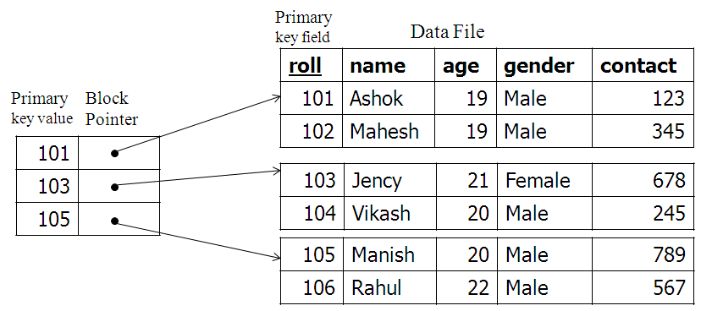
Primary Indexes
A primary index is an ordered file whose records are of fixed length with two fields. The first field is of the same data type as the ordering key field of the data file, called the primary key and the second field is a pointer to a disk block.
There is one index entry in the index file for each block in the data file. Each index entry has the value of the primary key field for the first record in a block and a pointer to that block as its two field values.

Slide 9
Primary Indexing
Indexing is done on primary key or any super key.
Data must be ordered according to index.
It is always sparse index.
One index record will contain -
Index column value
Block Pointer

Slide 10
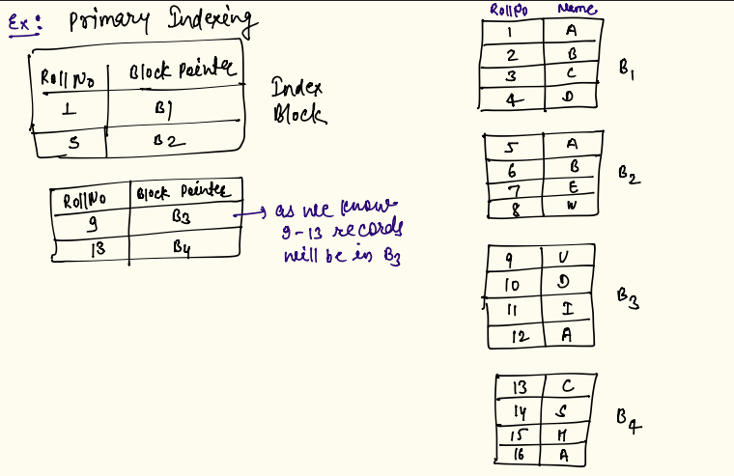
Primary Indexing

Slide 11
Primary Indexing
You are given a database with following information -
# records = 65536
record size = 64 bytes
key field size = 10 bytes
block pointer size = 22 bytes
block size = 256 bytes
Answer followings -
# records per block
# blocks required to store data
# of indexing entries
size of one indexing entry
Total index file size
# blocks required to store the indexing file

Slide 12
Primary Indexes
The index file for a primary index needs substantially fewer blocks than does the data file, for two reasons. First, there are fewer index entries than there are records in the data file. Secondly, each index entry is typically smaller in size than a data record because it has only two fields. A binary search on the index file hence requires fewer block accesses than a binary search on the data file.
When a user wants to insert a record to its correct position in the data file, the existing records should be moved to make space for the new record as well as index entries will be changed.
Similarly, deletion process is also difficult due to the index entries updation. But, record deletion is commonly handled by using deletion markers.

Slide 13
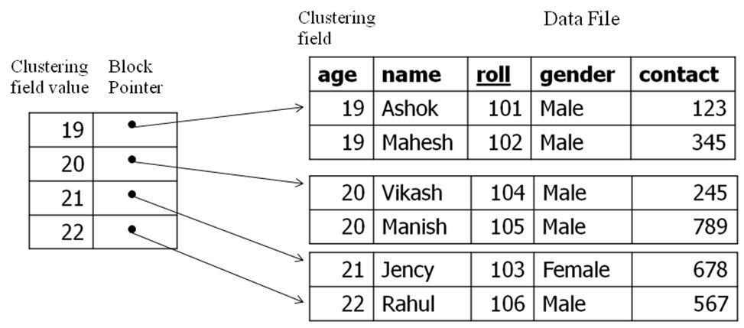
Clustering Indexes
If records of a file are physically ordered on a non-key field, that field is called the clustering field. Thus, clustering index is the index created on the clustering field to speed up retrieval of records that have the same value for the clustering field
This differs from a primary index, which requires that the ordering field of the data file have a distinct value for each record

Slide 14
Clustering Indexes…
There is one entry in the clustering index for each distinct value of the clustering field, containing the value and a pointer to the first block in the data file that has a record with that value for its clustering field.
To solve the problem of insertion, it is common to reserve a whole block (or a cluster of contiguous blocks) for each value of the clustering field; all records with that value are placed in the block (or block cluster). This makes insertion and deletion relatively straightforward.

Slide 15
Clustering Indexing
Indexing done on non-key field.
Data must be ordered according to index field.
It is a sparse indexing.
Indexing is done for unique non-key values.

Slide 16
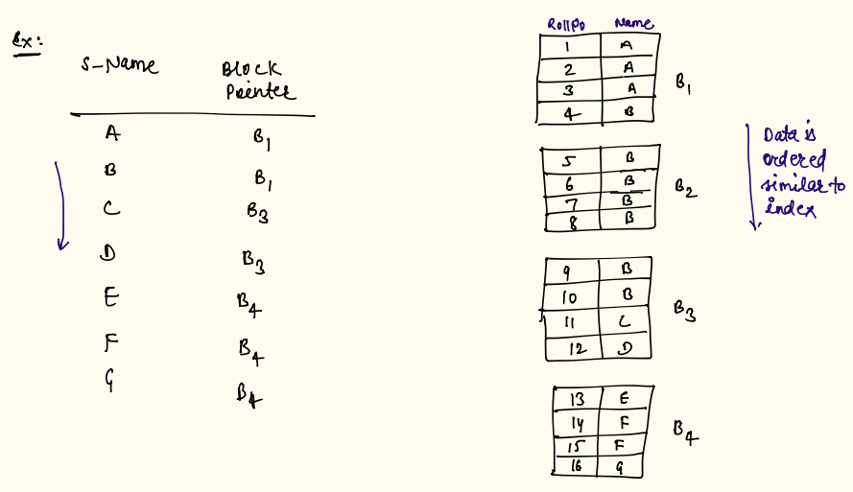
Clustering Indexing

Slide 17
Clustering Indexing
Suppose you are given a following database -
# records = 2^30
Block size = 4096 bytes
Index field = 10 bytes
Block pointer size = 22 bytes
# of distinct values in non-key field = 16384
Answer followings -
# records per block
# blocks required
index file entry size
# of index entries
Total size of index file
# Blocks required to store the index file

Slide 18
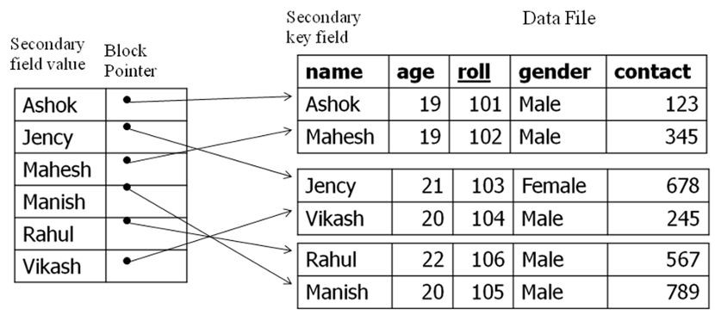
Secondary Indexes
A secondary index is also an ordered file with two fields. The first field is of the same data type as some non-ordering field of the data file that is an indexing field. The second field is either a block pointer or a record pointer. There can be many secondary indexes for the same file.
In this case there is one index entry for each record in the data file, which contains the value of the secondary key for the record and a pointer either to the block in which the record is stored or to the record itself.

Slide 19
Secondary Indexes…
A secondary index usually needs more storage space and longer search time than does a primary index, because of its larger number of entries.
Secondary index provides a logical ordering on the records by the indexing field.
A data file can have either a primary index or a cluster index depending on its ordering field. It can have several secondary indexes, however.

Slide 20
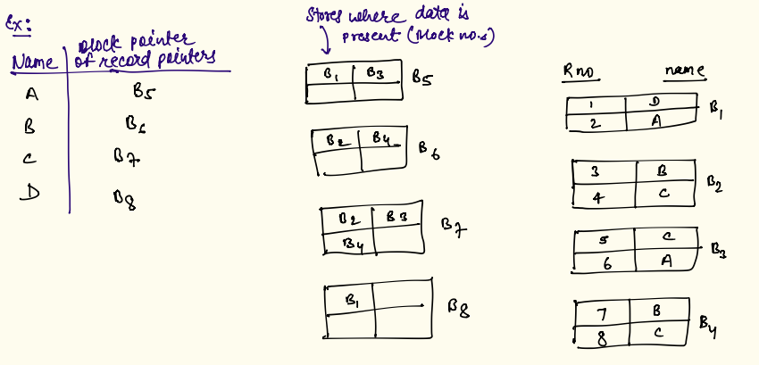
Secondary Indexing
Data need not to be sorted according to index.

Slide 21
Dense/Sparse Indexes
Indexes can also be characterized as dense or sparse:
A dense index has an index entry for every search key value (and hence every record) in the data file
A sparse or non-dense index has index entries for only some of the search values
Primary index → Non-dense
Clustering index → Non-dense
Secondary index → Dense

Slide 22
Multi-level Indexing
If the no of records in database table is huge then index file size will also be very huge. Therefore to search in this large index file, a lot of disk blocks will be accessed.
To improve this search time, we can do indexing of the index file also. This is known as multi-level indexing.

Slide 23
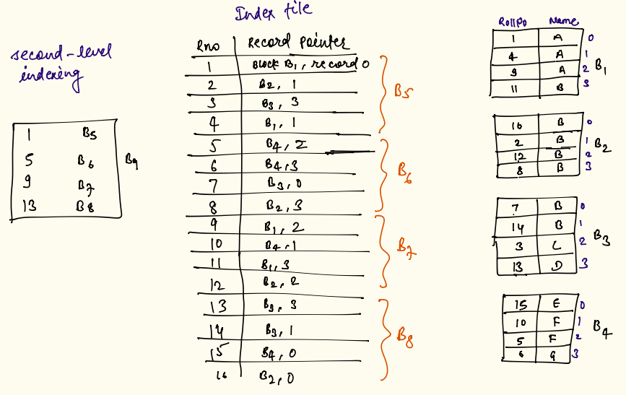
Multi-level Indexing

Slide 24
Multilevel Indexing
A multilevel indexing can contain any number of levels, each of which acts as a non-dense index to the level below. The top level contains a single entry.
A multilevel index can be created for any type of first-level index (whether it is primary, clustering or secondary) as long as the first-level index consists of more than one disk block.
The advantage of multilevel index is that it reduces the number of blocks accessed when searching a record, given its indexing field value.
The problems associated with index insertions and deletions still exist because all index levels are physically ordered files.
Because of the insertion and deletion problem, most multilevel indexes use B-tree or B+-tree data structures, which leave space in each tree node (disk block) to allow for new index entries.
In B-Tree and B -Tree data structures, each node corresponds to a disk block. Here, each node is kept between half-full and completely full.
An insertion into a node that is not full is quite efficient. On the other hand, if a node is full the insertion causes a split into two nodes.
Similarly, a deletion is quite efficient if a node does not become less than half full. If a deletion causes a node to become less than half-full, it must be merged.

Slide 25
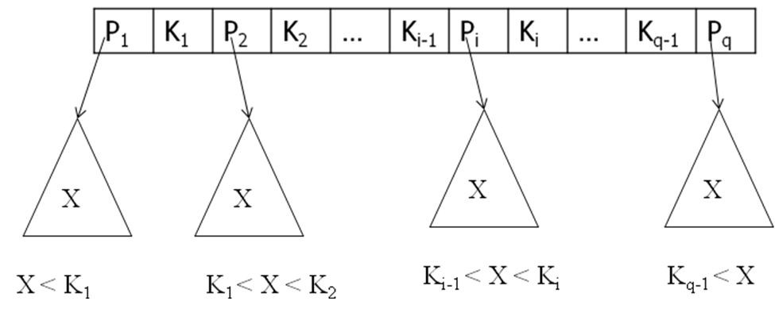
Search Trees
A search tree is a special type of tree that is used to search a record, given the value of one of the record’s fields.
A search tree of order ’p’ is a tree such that each node contains at most ’p-1’ search values and ’p’ pointers in the order < P1 , K1 , P2 , K2 , ... Pq-1 , Kq−1,Pq>, where q ≤ p; each P is a pointer to a child node and each K is a search value from some ordered set of values.
All of these search values are unique

Slide 26
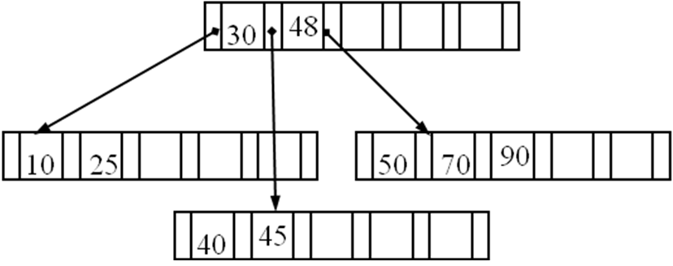
Search Trees…
Two constraints must hold at all times on the search tree:
Within each node, K1 < K2 < ... < Kq−1
For all values X in the subtree pointed at by Pi , X < K1; Ki−1 < X < Ki for 1 < i < q; and Ki−1 < X for i = q
When a user wants search a value X, he has to follow the appropriate pointer Pi according to the formula in condition 2.
A search tree is balanced when all of its leaf nodes are at the same level.

Slide 27
B-Trees
B-tree is a specialized multi-way tree designed especially for use on disk. A B-tree of order ’p’ can be defined as follows:
Each internal node is of the form <P1, <K1>, P2, <K2> ...<Kq−1>, Pq > , where q ≤ p. Each Pi is a tree pointer, which is a pointer to another node in the B-tree
Within each node, K1 < K2 < ... <Kq−1
Each node has at most ’p’ tree pointers
For all search key field values X in the subtree pointed by Pi , the rule is X < K1; Ki−1 < X < Ki for 1 < i < q; and Ki−1 < X for i = q
All non-leaf nodes except the root have at least ⌈ p / 2 ⌉ children. The root is either a leaf node, or it has from two to p children
A node with q tree pointers, q ≤ p, has q-1 search key field values
All leaf nodes are at the same level. Leaf nodes have the same structure as internal nodes except that all of their tree pointers Pi are null

Slide 28
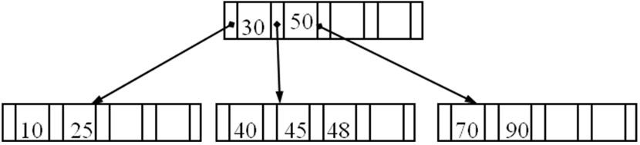
B-Trees
The insertion to a B-tree is an easier process. A B-tree starts with a single root node at level 0. The rules for the insertion to B-tree are:
It attempts to insert the new key into a leaf. If this would result in that leaf becoming too big, split the leaf into two, promoting the middle key to the leaf’s parent
If the insertion would result in the parent becoming too big, split the parent into two, promoting the middle key. This strategy might have to be repeated all the way to the top
If necessary, the root is split in two and the middle key is promoted to a new root, making the tree one level higher
Ex: Draw the B-tree of the order 5 for the data items 10, 50, 30, 70, 90, 25, 40, 45, 48 ?

Slide 29
B-Trees Deletion
At deletion, removal should be done from a leaf:
If the key is already in a leaf node, and removing it doesn’t cause that leaf node to have too few keys, then simply remove the key to be deleted
If the key is not in a leaf, then it is guaranteed that its predecessor or successor will be in a leaf. In this case, delete the key and promote the predecessor or successor key to the non-leaf deleted key’s position
If first or second condition lead to a leaf node containing less than the minimum number of keys, then look at the siblings immediately adjacent to the leaf:
If one of them has more than the minimum number of keys, then promote one of its keys to the parent and take the parent key into the lacking leaf
If neither of them has more than the minimum number of keys, then the lacking leaf and one of its neighbours can be combined with their shared parent; & the new leaf will have the correct number of keys. If this step leaves the parent with too few keys, repeat the process up to the root itself

Slide 30
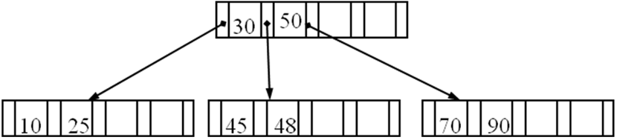
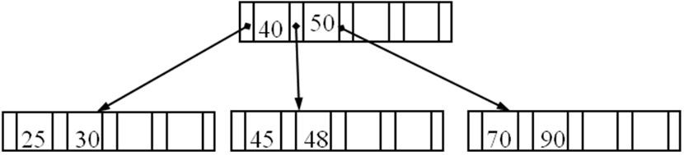
B-Trees Deletion
Deletion of 40
Deletion of 10
The maximum number of items in a B-tree of order p and height h = p^{h+1} - 1. For example, when the order p=5 and height h=1, the maximum number of nodes= 5²-1=24

Slide 31
B+-Trees
The leaf nodes of the B⁺-tree are usually linked together to provide ordered access on the search field to the records. These leaf nodes are similar to the first level of an index
Internal nodes of the B⁺-tree correspond to the other levels of a multilevel index. The structure of the internal nodes of a B⁺-tree of order p is as follows:
Each internal node is of the form <P₁, <K₁>, P₂, <K₂> ...<K_{q−1}>, P_{q} > , where q ≤ p and each P_{i} is a tree pointer
Within each internal node, K₁ < K₂ < ... <K_{q−1}
Each internal node has at most ’p’ tree pointers
For all search field values X in the sub-tree pointed by P_{i} , the rule is X ≤ K₁; K_{i−1} < X ≤ K_{i} for 1 < i < q; and K_{i−1} < X for i = q
Each internal node has at least ⌈ p / 2 ⌉ children. The root has at least two children if it is an internal node
An internal node with q tree pointers, q ≤ p, has q-1 search key field values

Slide 32
B+-Trees
The structure of the leaf nodes of a B⁺-tree of order p is as follows:
Each leaf node is of the form <K₁, Pr₁>, <K₂, Pr₂> ...<K_{q−1}, Pr_{q−1}>, P_{next} >, where q ≤ p, each Pr_{i} is a data pointer and P_{next} is the pointer to the next leaf node
Each leaf node has at least ⌈ p / 2 ⌉ values
All leaf nodes are at the same level
Within each leaf node, K₁ ≤ K₂ ≤ ... ≤ K_{q−1}
The pointers in internal nodes are the tree pointers, which point to blocks that are tree nodes, whereas the pointers in leaf nodes are the data pointers to the data file records.

Slide 33
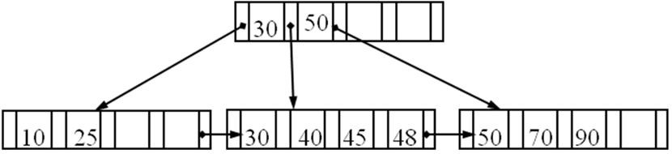
B+-Trees Insertion
The rules for the insertion of a data item to the B+-tree are:
Find correct leaf L
Put data entry onto L. There are two options for this entry:
If L has enough space, done!
Else, split L into L and a new node L2. Redistribute entries evenly and copy up the middle key. Also, insert index entry pointing to L2 into parent of L
For each insertion, this process will be repeated

Slide 34
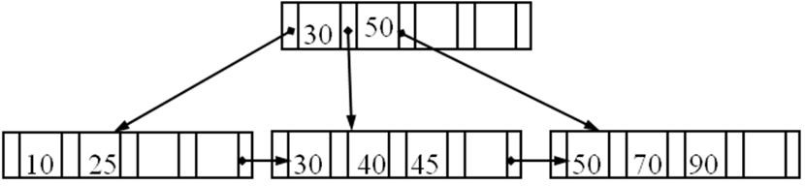
B+-Trees Deletion
The rules for deleting a data item from the B+-tree are:
Find the correct leaf L.
Remove the entry. There may be two possible cases for this deletion:
If L is at least half-full, done!
Else, try to re-distribute the entries by borrowing from the adjacent node or sibling. If re-distribution fails, merge L and the sibling. If merge occurred, then delete the entry (pointing to L or sibling) from parent of L.
The merging process could propagate to root; thus, decreasing the height.
Deletion of 48:

Slide 35
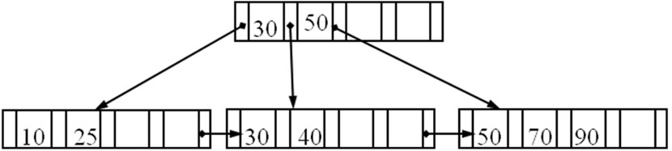
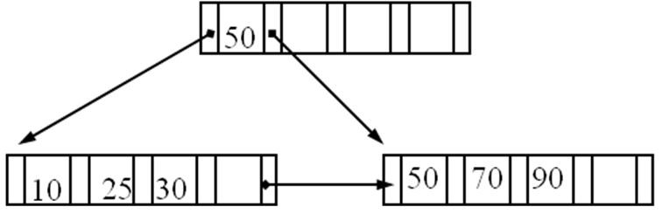
B+-Trees Deletion
Deletion of 45 followed by 40:
The maximum number of records stored in a B⁺-tree of order p and height h = p^{h} - p^{h−1}. Similarly, the minimum number of records stored = 2(p/2)^{h−1}; and the minimum number of keys in a B⁺-tree of order p and height h = 2(p/2)^{h} - 1.

Slide 36
B-Trees vs. B+-Trees
B+-tree searching is faster than the B-tree searching; because in B -tree, all records are stored at the leaf level of the tree; and only keys are stored in interior nodes.
B+-tree takes more storage space than B-tree, because it uses extra pointers than B-tree.
Insertion and deletion operations in B-tree are more complex than those in B+-tree.

Slide 37
B-Tree
Searching in indexing is linear.
To improve the search time, store indexing in B or B+ Trees.

Slide 38
B-Tree
Tree based indexing.
Dynamic indexing technique. It allows insertion and deletion of indexes.
Based on insertion, deletion, tree is automatically adjusted.
Self-balancing search tree.
It can grow vertically and horizontally, meanwhile BST grows vertically only.

Slide 39
An order p B-Tree
Every node has at max p tree pointers (pointing to child nodes).
Every node other than root should have at least ceil (p/2 - 1) keys.
In every node, there are at most p-1 keys and p tree pointers.
Root can have minimum 1 key and 2 tree pointers.
All leaves appear on the same level.

Slide 40
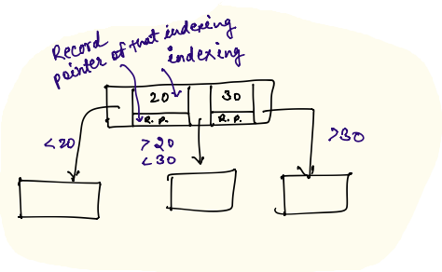
B-Tree Node Structure
Key
Record Pointer => points to block where actual index is stored.
Tree Pointer => points to child nodes.

Slide 41
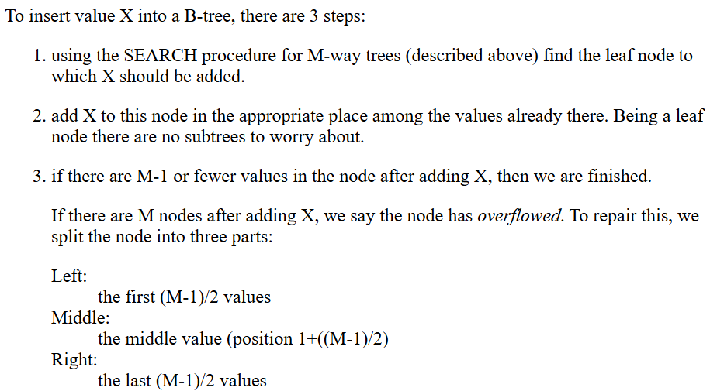
B-Tree Insertion

Slide 42
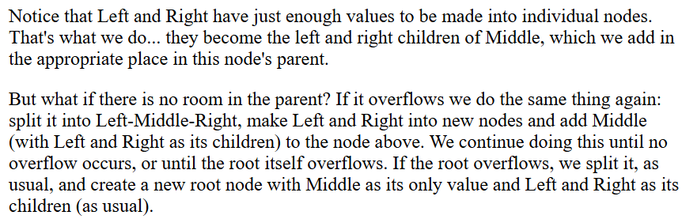
B-Tree Insertion Continued...
https://webdocs.cs.ualberta.ca/~holte/T26/ins-b-tree.html#:~:text=Left%20and%20Right%20become%20nodes%2C%20the%20children%20of%20Middle.,level%20deeper%20in%20the%20tree.

Slide 43
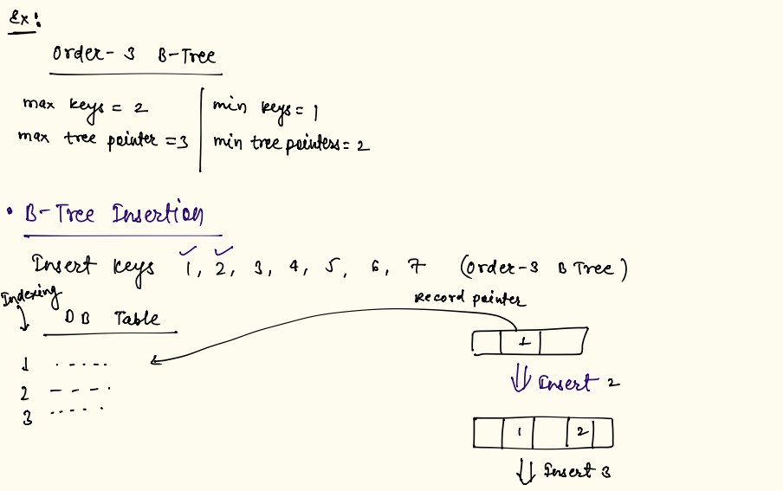
B-Tree Insertion Example

Slide 44
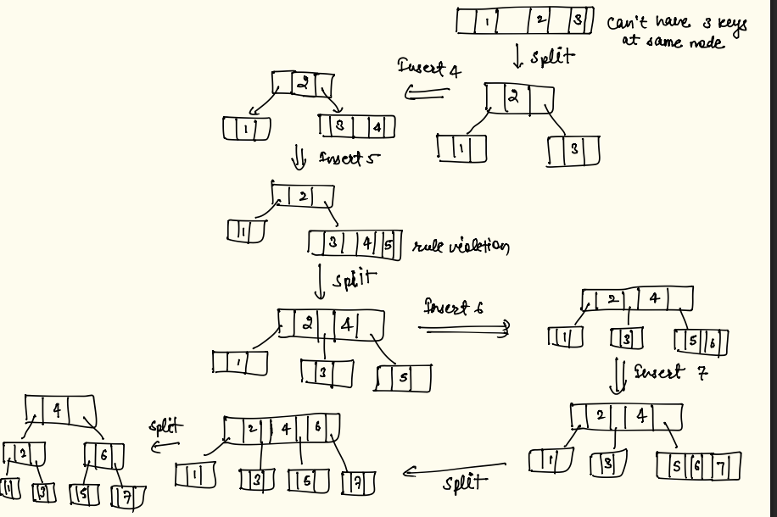
B-Tree Insertion Example Continued...

Slide 45
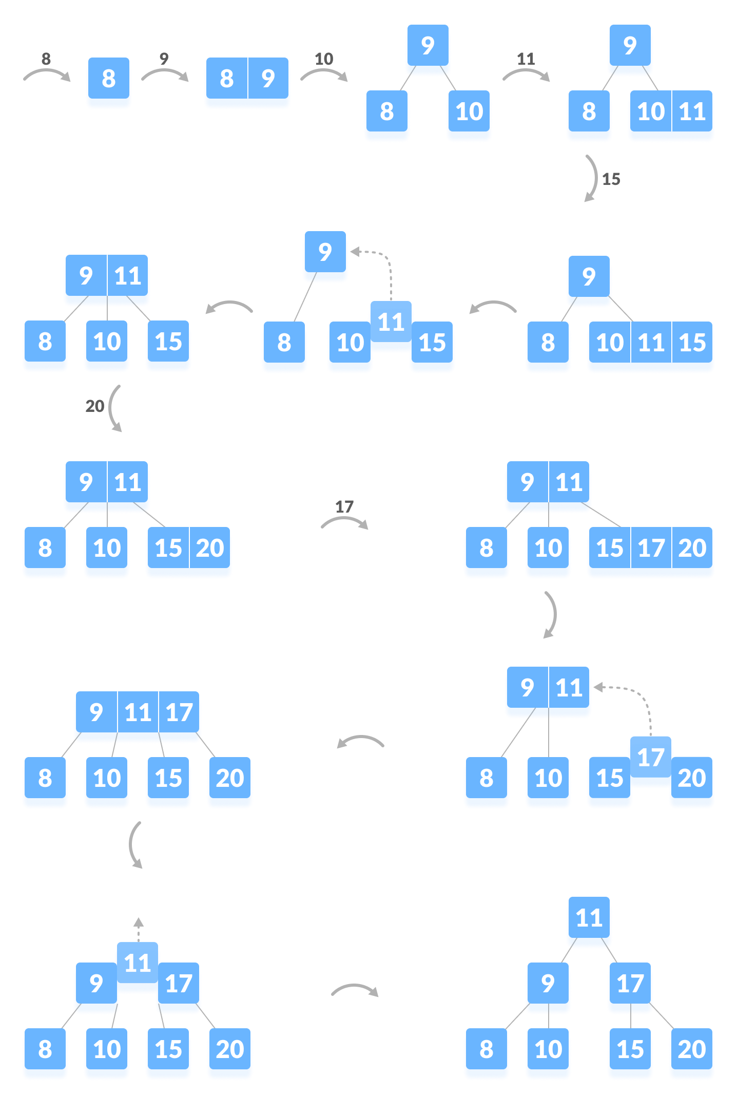

Slide 46
B-Tree Deletion
Case-1: Deletion at leaf
After deletion if there is no violation of min keys then no changes in tree
If violation of min keys then borrow key from sibling (rotation through parent)
If borrow from sibling can’t be possible (when sibling also have min number of keys) then merge the node with sibling and pull down the anchor key from parent.

Slide 47
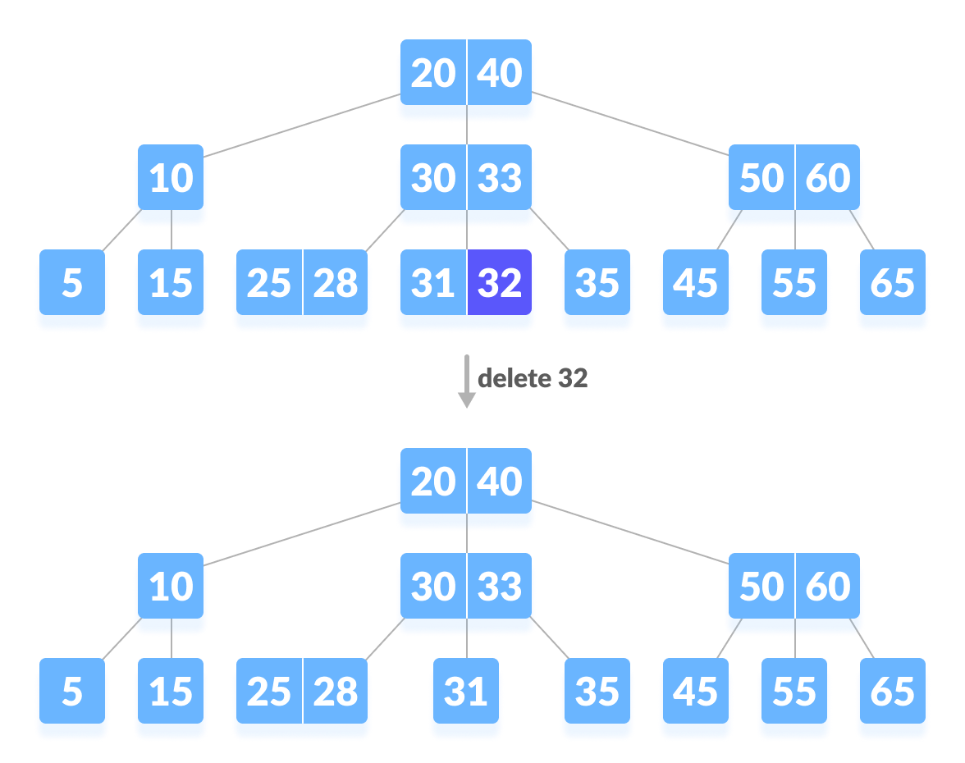
B-Tree Deletion: Case-1
A B-Tree of order 3.

Slide 48
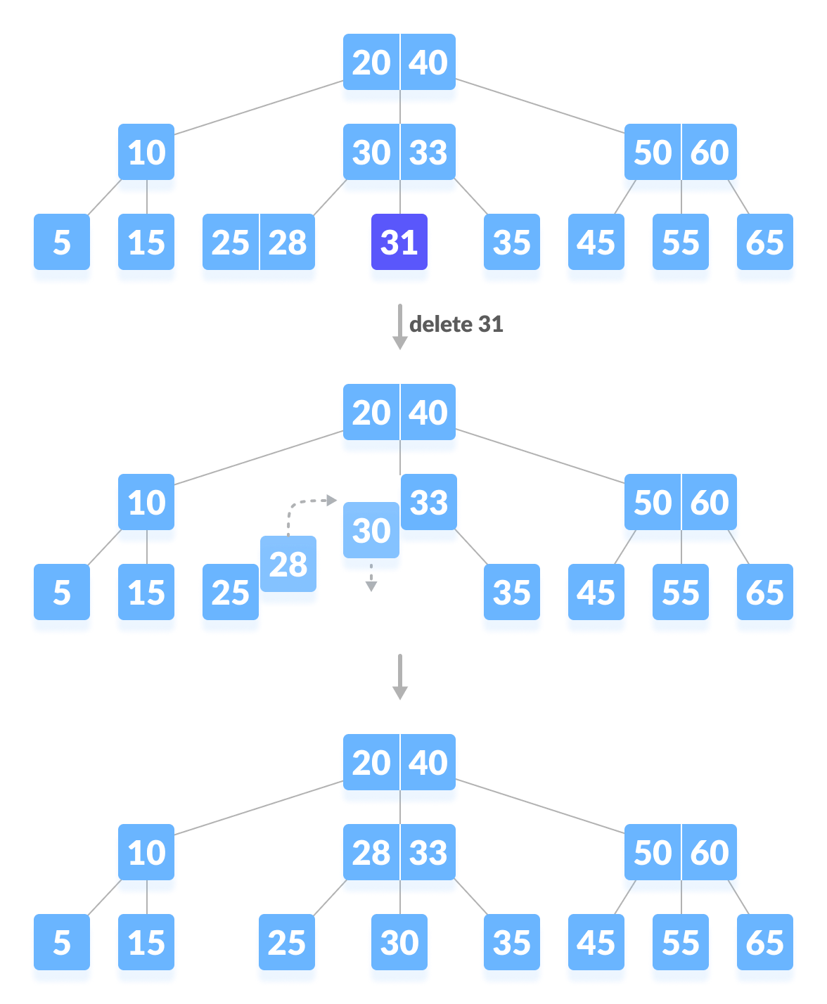

Slide 49
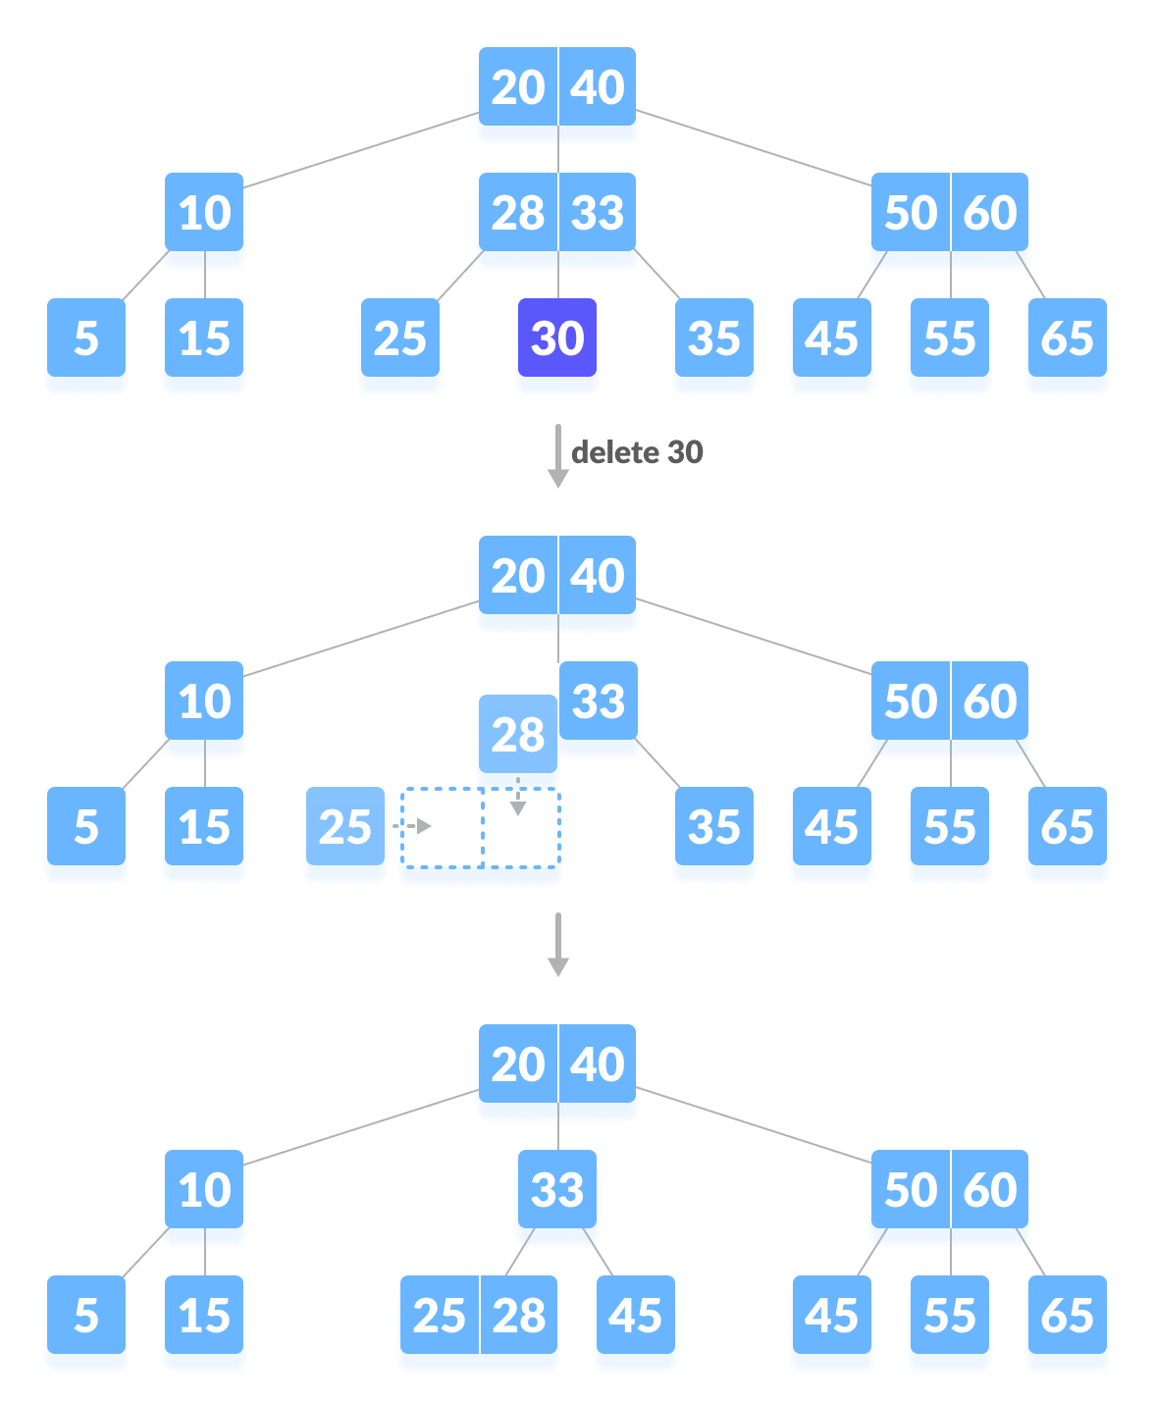

Slide 50
B-Tree Deletion
Case-2: Deletion at Internal Node
Replace the deleted value with inorder successor or predecessor
Now follow the rule of deletion of key from leaf node.

Slide 51
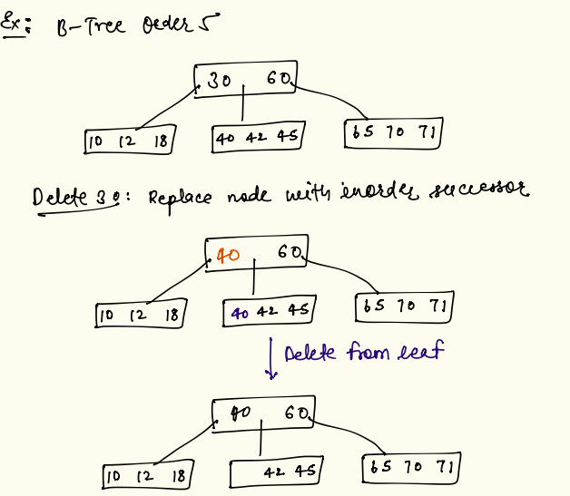
B-Tree Deletion

Slide 52
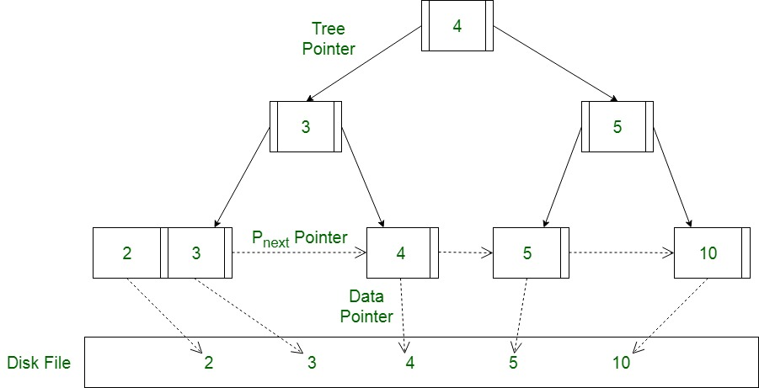
B+ Trees
Internal Node (order p)
Keys
Tree Pointers
Leaf Node (order q)
keys
Record pointers
Linked List Pointers
Advantage: Range queries takes less time.
Select * from students where marks > 50 and marks < 80;

Slide 53
B+ Tree
Order for internal nodes (order p)
Every internal node other than root should have at least ceil(p/2 - 1) keys and ceil(p/2) tree pointers.
Every internal node can have maximum p-1 keys or p tree pointers.
Order for leaf nodes (order q)
Every leaf node should have at least ceil(q/2) keys and max q keys.
All leaves are on same level.
The leaves are connected using linked list (singly or doubly).

Slide 54
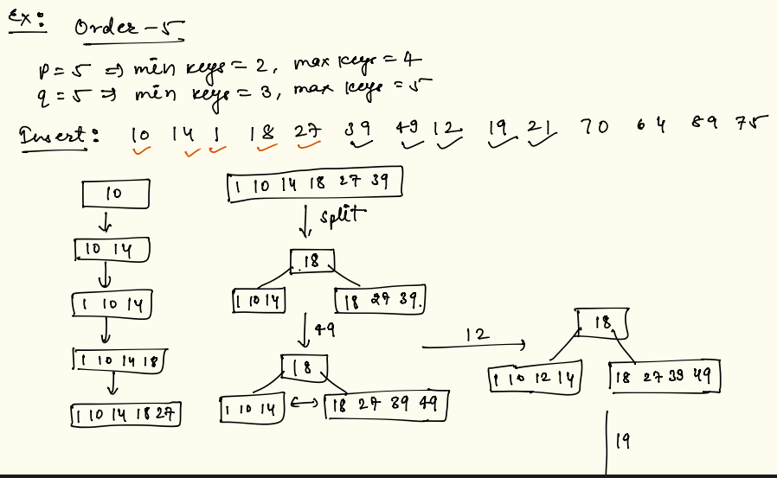
B+ Tree Insertion

Slide 55
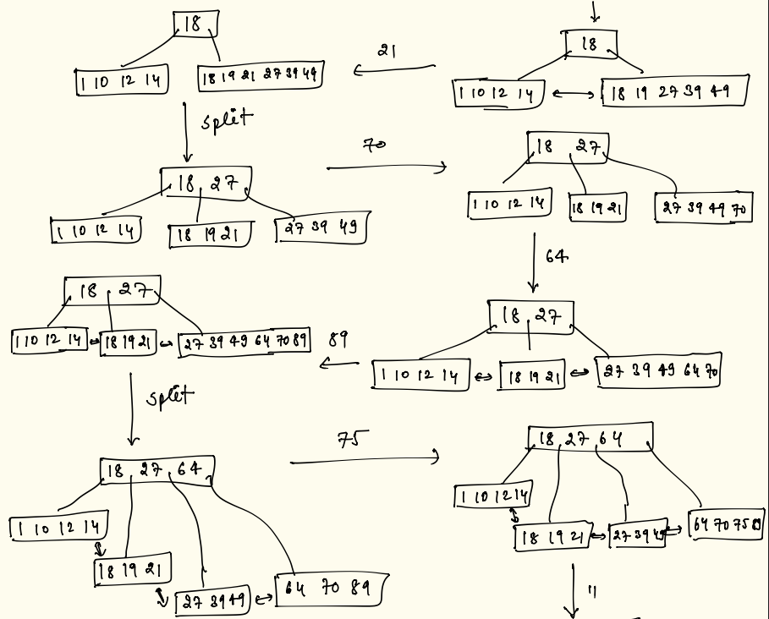

Slide 56
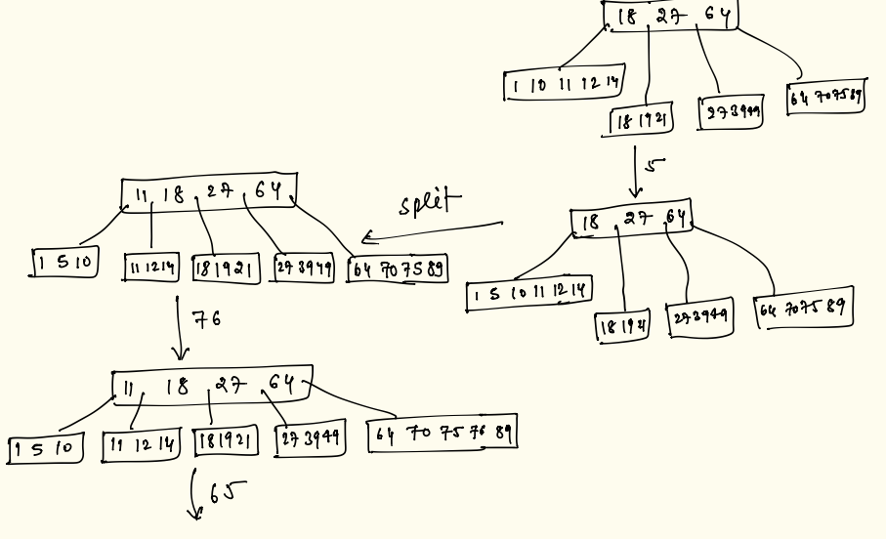

Slide 57
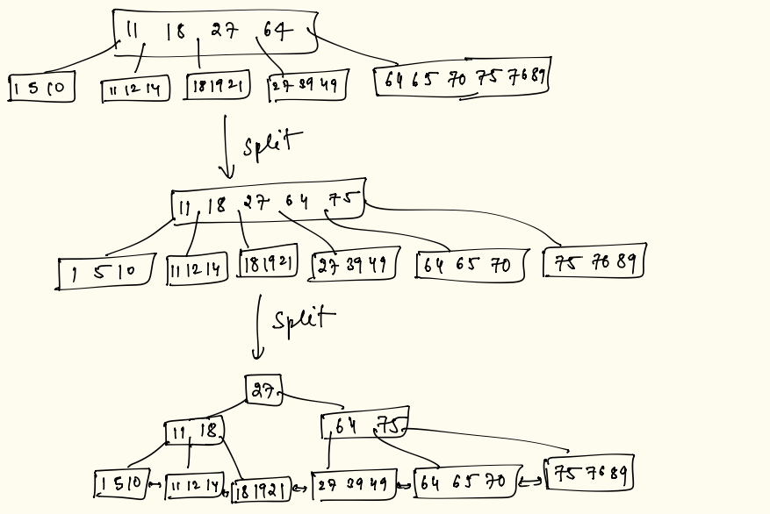

Slide 58
B+ Tree Deletion
After deletion if no violation of min keys then no changes in tree.
If violation of min keys then borrow key from siblings and update the anchor.
If borrow from sibling can’t be possible then merge the node with sibling node. And either remove the anchor key (merge on leaf) or pull down the anchor key from parent (merge on internal node)

Slide 59
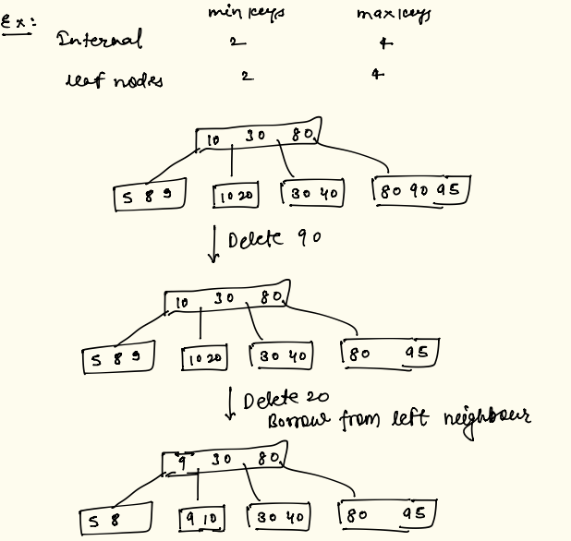

Slide 60
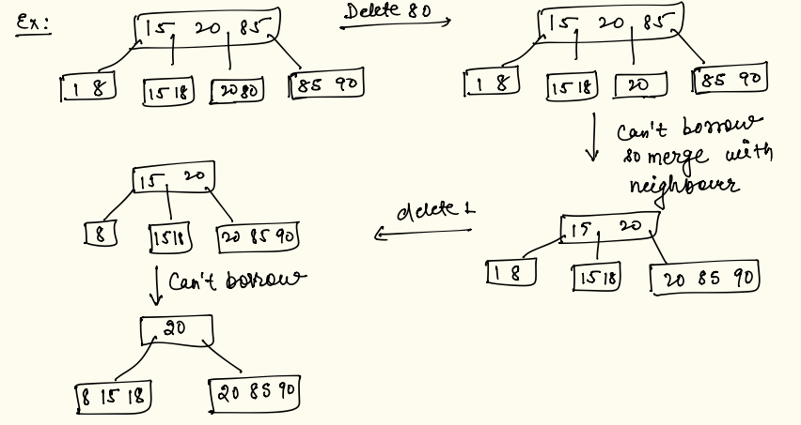

Slide 61

Exercise

Slide 62
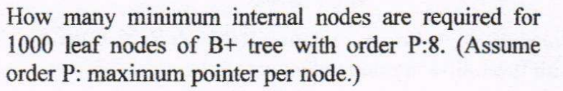
Exercise

Slide 63
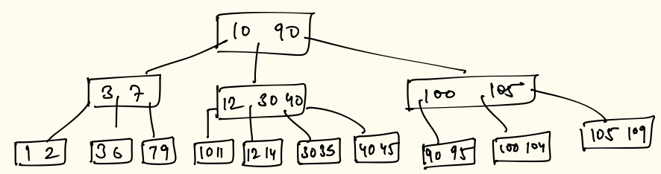
Exercise
Given a B+ Tree of order 4.
Delete following values from the tree in given order -
1. 2
2. 109
3. 12

Slide 64
Exercise
Create a B Tree of order 4 with following keys -
15, 5, 8, 22, 10, 1

